Slide 1
Concurrency Part II:
The return of the (burger) king

Slide 2

Burgers

Slide 3





Ingredients
+
+
+
+
=

Slide 4



Kitchen
Pantry
Cutting Board
Grill

Slide 5
Making Burgers

Slide 6


Chapter 1: Single threaded burgers
The story of a single burger

Slide 7


Chapter 1: Single threaded burgers

Slide 8

Chapter 1: Single threaded burgers

Slide 9
Chapter 1: Single threaded burgers

Slide 10
Chapter 1: Single threaded burgers

Slide 11


Chapter 1: Single threaded burgers

Slide 12
Chapter 1: Single threaded burgers
Receive Order

Slide 13
Chapter 1: Single threaded burgers
2. Gather ingredients

Slide 14
Chapter 1: Single threaded burgers
3. Prepare ingredients

Slide 15
Chapter 1: Single threaded burgers
4. Build burger

Slide 16
Chapter 1: Single threaded burgers
5. Profit!

Slide 17
DEMO: 01-st_restaurant.py

Slide 18
Chapter 2: Multi-threaded burgers

Slide 19

Chapter 2: Multi-threaded burgers

Slide 20
DEMO: 02-mt_restaurant.py

Slide 21
Chapter 2.1: Multi-threaded burgers
(with Locks)

Slide 22


Chapter 2.1: Multi-threaded burgers
(with Locks)

Slide 23
Chapter 2.1: Multi-threaded burgers
(with Locks)

Slide 24
Chapter 2.1: Multi-threaded burgers
(with Locks)

Slide 25
Chapter 2.1: Multi-threaded burgers
(with Locks)

Slide 26
Chapter 2.1: Multi-threaded burgers
(with Locks)

Slide 27
DEMO: 03-locking_restaurant.py

Slide 28
Chapter 3: Parallel burgers

Slide 29
Chapter 3: Parallel burgers

Slide 30
DEMO: 04-parallel_kitchens.py

Slide 31

Chapter 3.1: Parallel stations
(pipeline)

Slide 32
DEMO: 05-parallel_stations.py

Slide 33
Chapter 3.2: Parallel restaurant
(parallel pipeline)

Slide 34
DEMO: 06-parallel_restaurant.py

Slide 35
Chapter 4: Actor-model burgers

Slide 36


Chapter 4: Actor-model burgers
Actor Model!

Slide 37
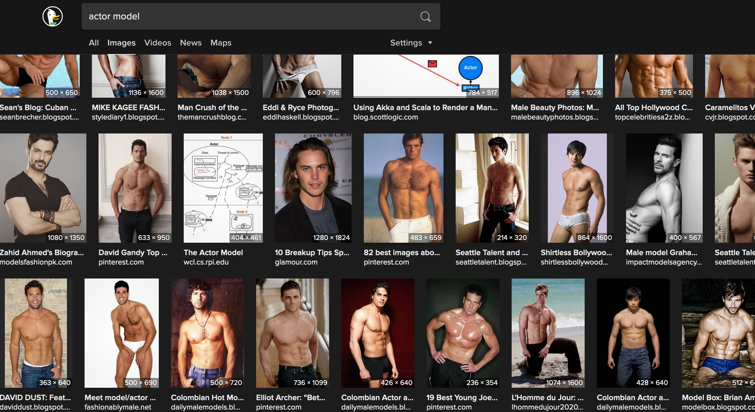

Chapter 4: Actor-model burgers
Actor Model!

Slide 38

Chapter 4: Actor-model burgers
Actor Model!

Slide 39

Chapter 4: Actor-model burgers
Actor

Slide 40

Chapter 4: Actor-model burgers
Actor

Slide 41

Chapter 4: Actor-model burgers
Actor

Slide 42
Chapter 4: Actor-model burgers

Slide 43
Chapter 4: Actor-model burgers

Slide 44
DEMO: 07-actor_restaurant.py

Slide 45
Chapter 4.1: Actor-model burgers
You need a manager!

Slide 46
Chapter 4: Actor-model burgers

Slide 47
Chapter 4: Actor-model burgers

Slide 48
DEMO: 08-managed_actor_restaurant.py

Slide 49
Chapter 5: Async burgers

Slide 50


Chapter 5: Async burgers

Slide 51


Chapter 5: Async burgers
Cooperative:
Well behaved tasks.
Non-Blocking
Async all the way:
Async implementations
Task runners…
Smart cancelable jobs

Slide 52
DEMO: 09-async_restaurant.py

Slide 53
DEMO: 10-locking_async_restaurant.py

Slide 54
DEMO: 09-async_restaurant.py
(fix: One “kitchen” per task)

Slide 55
Summary

Slide 56
Summary-ish
(sorry… it’s quite long)

Slide 57
Single Threaded
Simple, naive implementation.

Slide 58
Single Threaded
Simple, naive implementation.
You should always start here.

Slide 59
Multiple Threads
Big PRO: Threads can share state.

Slide 60
Multiple Threads
Big PRO: Threads can share state.
Big CON: Threads can share state.

Slide 61
Multiple Threads
Big PRO: Threads can share state.
Big CON: Threads can share state.
Is harder than it looks.

Slide 62
Multiple Threads
Big PRO: Threads can share state.
Big CON: Threads can share state.
Is harder than it looks.
My opinion: avoid, if possible.

Slide 63
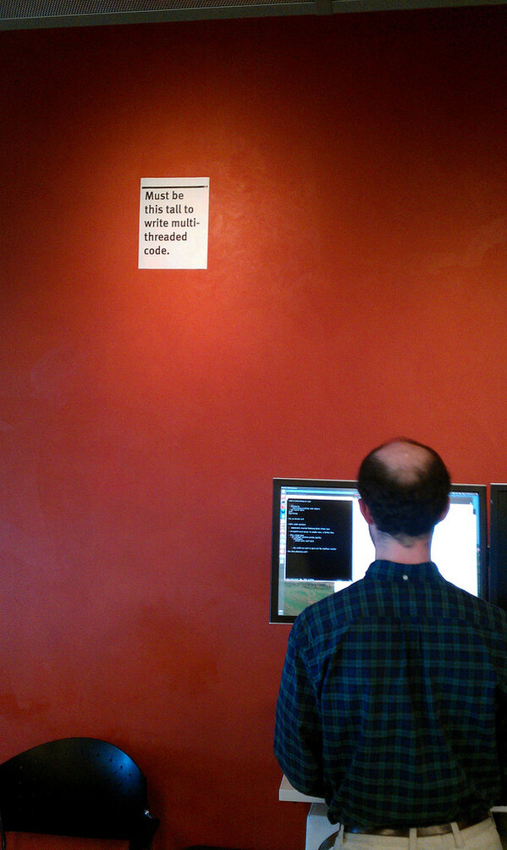

Multiple Threads
Big PRO: Threads can share state.
Big CON: Threads can share state.
Is harder than it looks.
My opinion: avoid, if possible.
@Mozilla

Slide 64
Multiple Threads
Big PRO: Threads can share state.
Big CON: Threads can share state.
Is harder than it looks.
Avoid, if possible.

Slide 65
Multiple Threads
Big PRO: Threads can share state.
Big CON: Threads can share state.
Is harder than it looks.
My opinion: avoid, if possible.
Bound to a single host.
Use to leverage host features (heterogeneous workloads).

Slide 66
Parallelism
Requires “data parallelism”.

Slide 67
Parallelism
Requires “data parallelism”.
Spoilers:
FP (paradigm) helps.
Actor model is great!
Multiple implementations: Actix, Akka, pykka.

Slide 68
Parallelism
Requires “data parallelism”.
Spoilers:
FP (paradigm) helps.
Actor model is great!
Multiple implementations: Actix, Akka, pykka.
Other patterns:
Observer, Prod-Cons, Pub-Sub.

Slide 69
Parallelism
Requires “data parallelism”.
Can’t share state.
Enables distributed systems.
Can leverage host’s compute features.

Slide 70
Async/Await
Requires ”well behaved” tasks.
Depends on async infrastructure.
Smart “Runner” loop (language/framework).
Async IO
Can share state (but shouldn’t).
Won’t help in compute heavy workloads.
Opinion: use if possible, treat as parallel.

Slide 71
Single vs Multi vs Parallel vs Async

Slide 72
Single vs Multi vs Parallel vs Async
(it depends)

